Slide 1
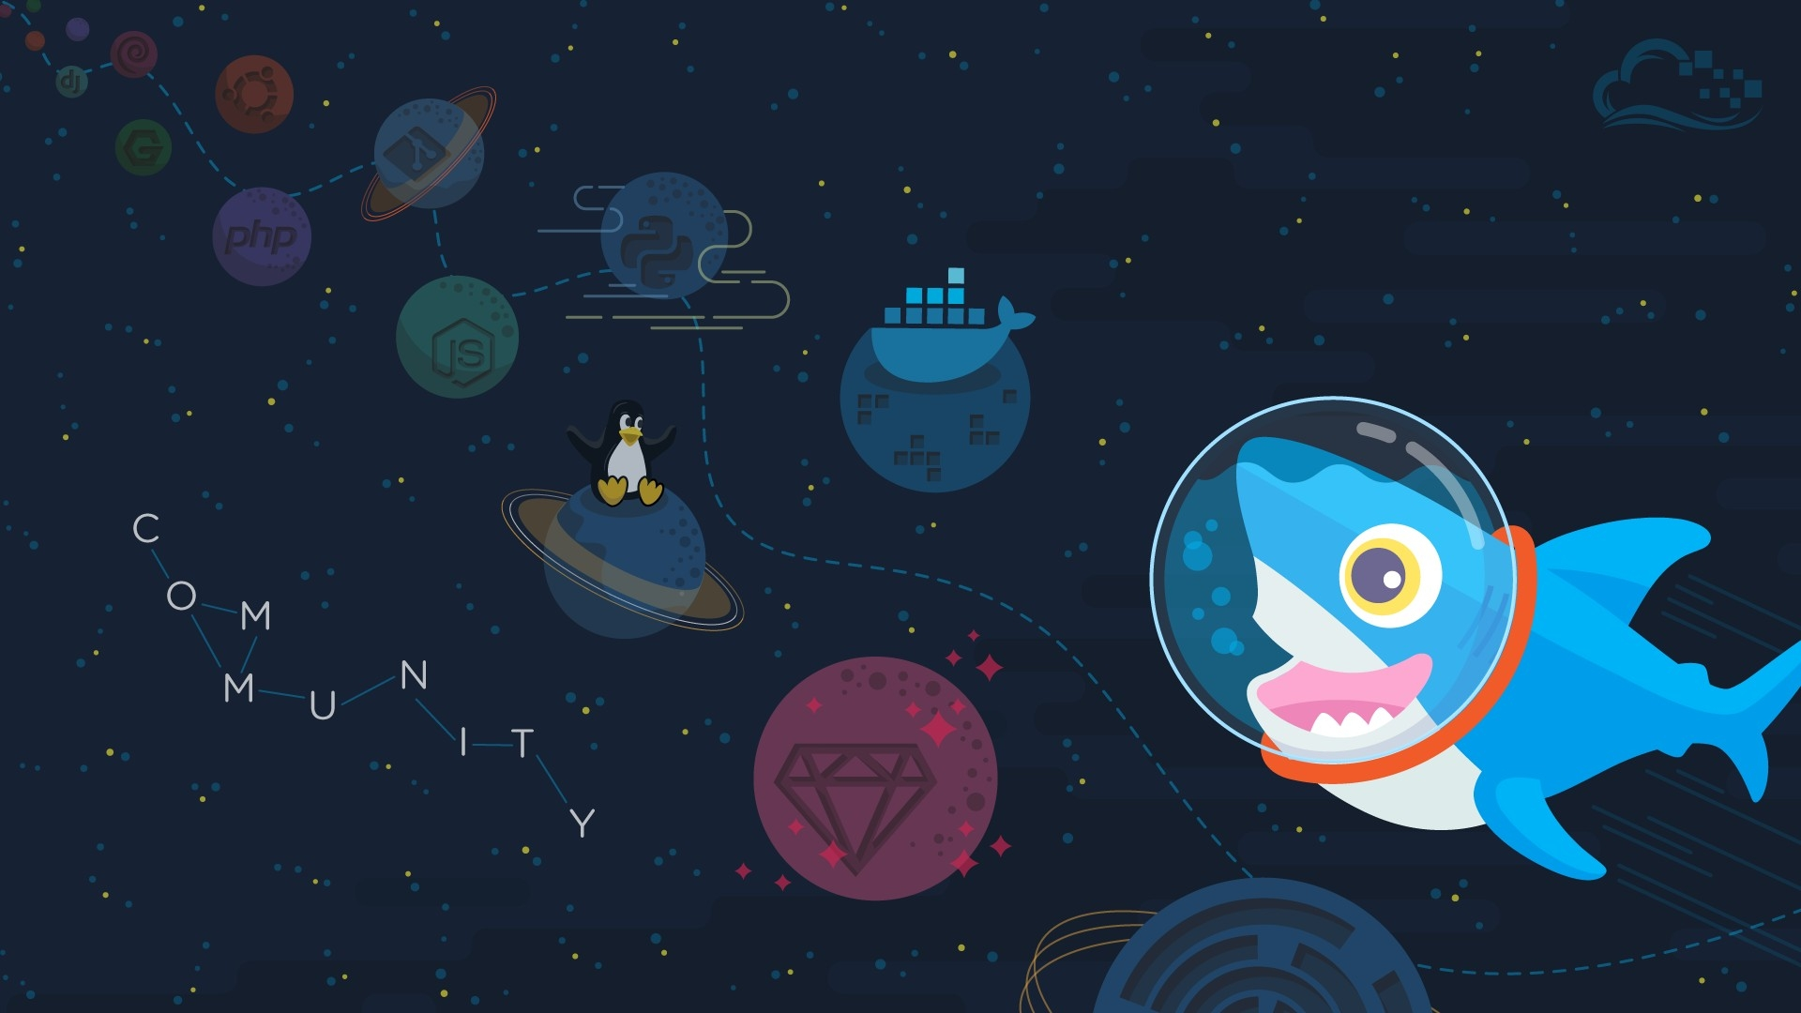
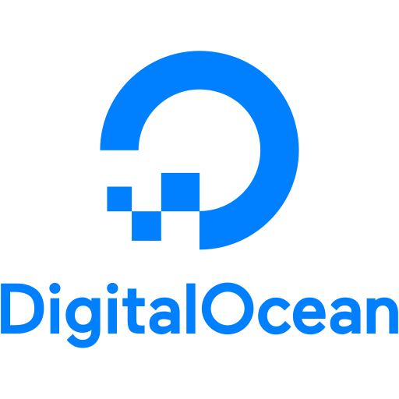
Chatbot For Digital Ocean
By,
Yash Sodha Kaivan Shah Harshil Shah

Slide 2
What are we aiming for?
We are Creating a Google assistant Chatbot which is having ability to:
Create a single click chatbot which provides facilities like
Create Droplet
It will be linked with Digital Ocean directly and creates Droplet in just single click.
Create Snapshot
It gives description/SnapShot of the Droplet.

Slide 3
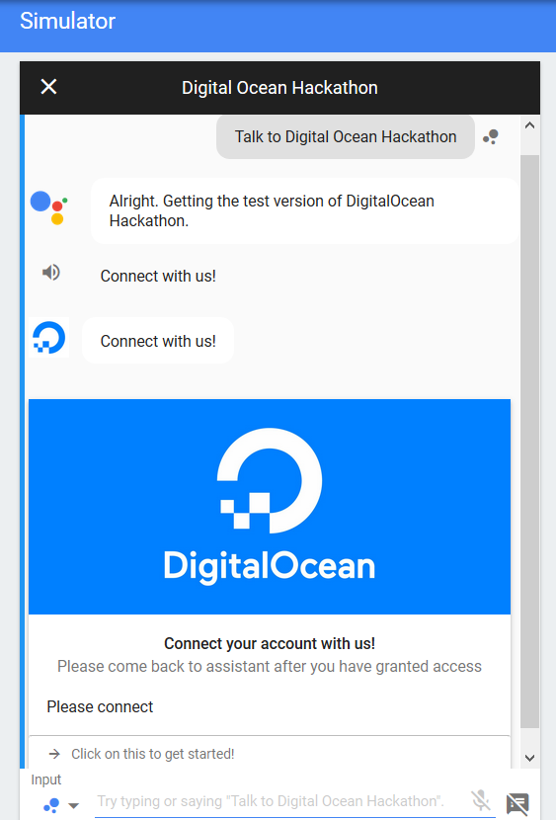
Start interacting with bot
It is really simple.
Like “Ok, Google!” we just have to say “Talk to Digital Ocean Hackathon” and your automation journey starts.

Slide 4
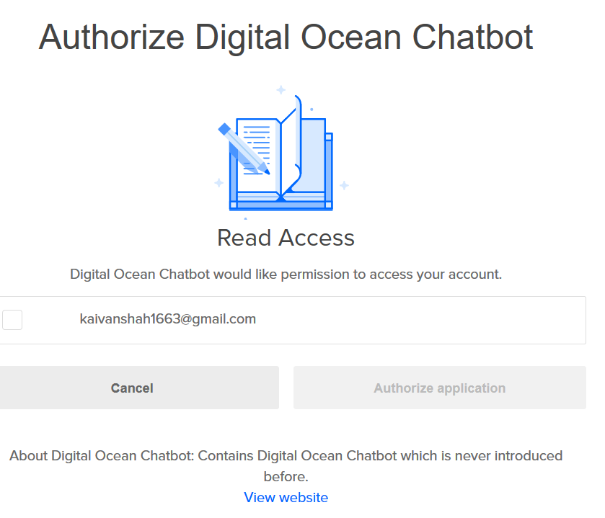
Login in Digital Ocean
User should have a Digital Ocean account while login.
If one have not created account on digital ocean they can create on the redirected page.
It uses OAuth Authentication to authenticate user.

Slide 5

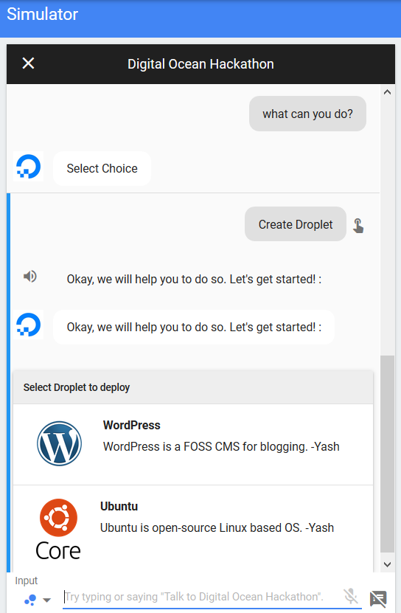
Choose..
You can choose Your option by just saying “What can you do?” Or “Give Options”.
It Provides several options like create a Droplet, delete Droplet or Deploy a Snapshot.

Slide 6
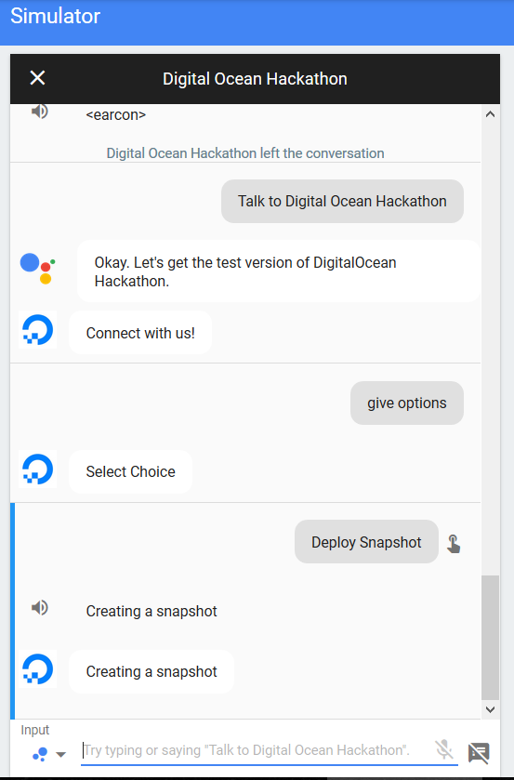

By clicking On
Create Droplet – Directly Creates Droplet on available Platforms by the help of Digital Ocean.
Deploy Snapshot – Give Details about Droplet

Slide 7
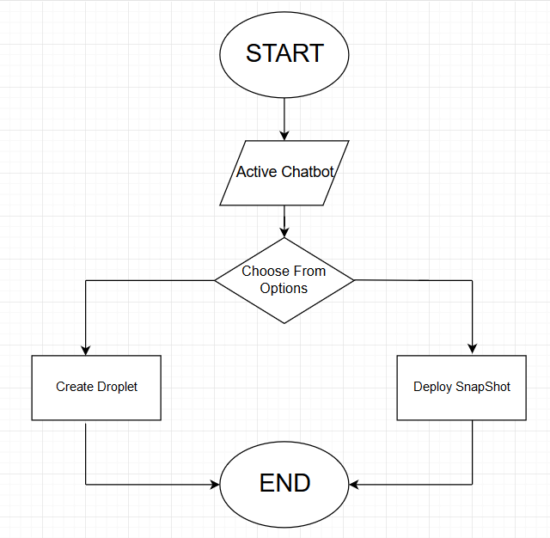
Flow Chart

Slide 8
What we have used?
Create and Deploy:
Digital Ocean
Chatbot building:
Dialog-flow by Google Inc.
Combining tool/ Linking Language:
Node.js

Slide 9

Thank You
By,
Harshil Shah Kaivan Shah Yash Sodha

